Slide 1
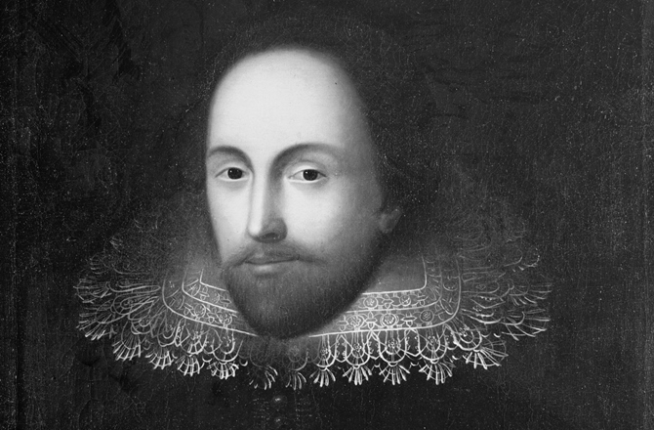

Slide 2
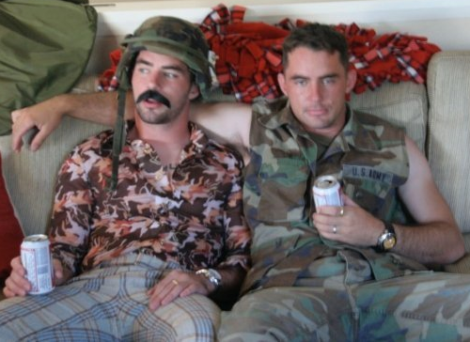
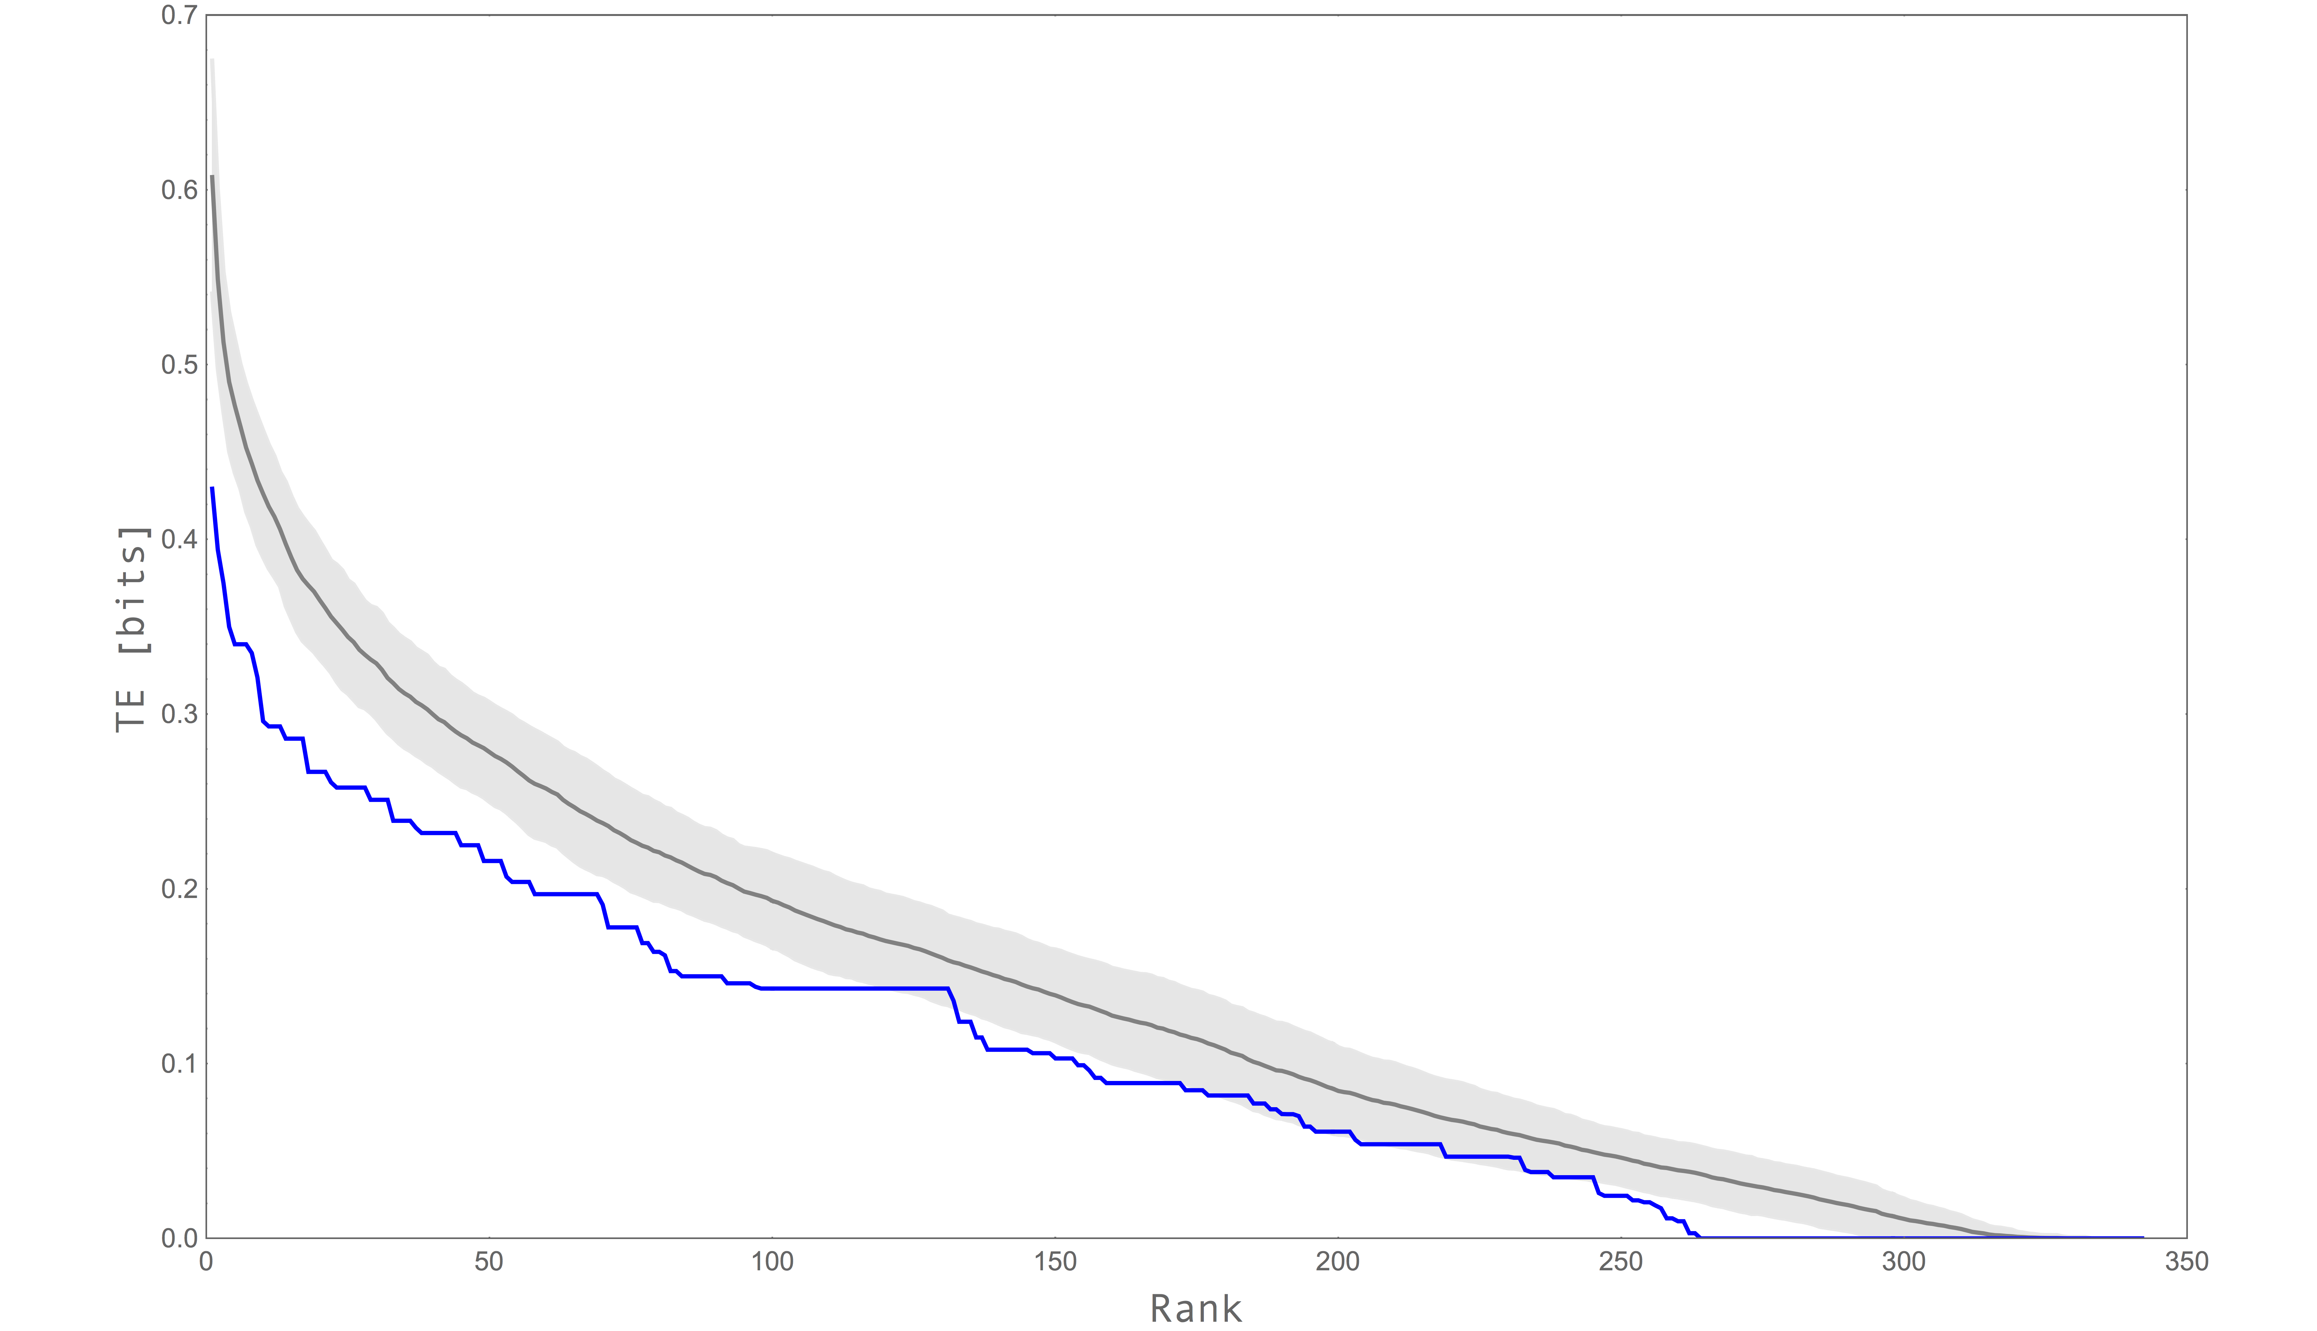
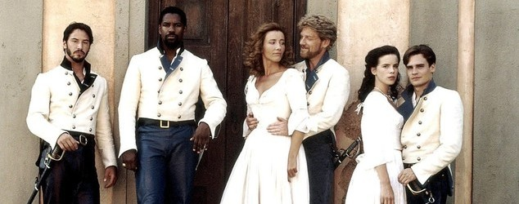
Scientist
( data )
Including
Denzel
math
Test Subjects
Notes:
Proof that this project contians all the facets of a ligitamit science expeiriment

Slide 3
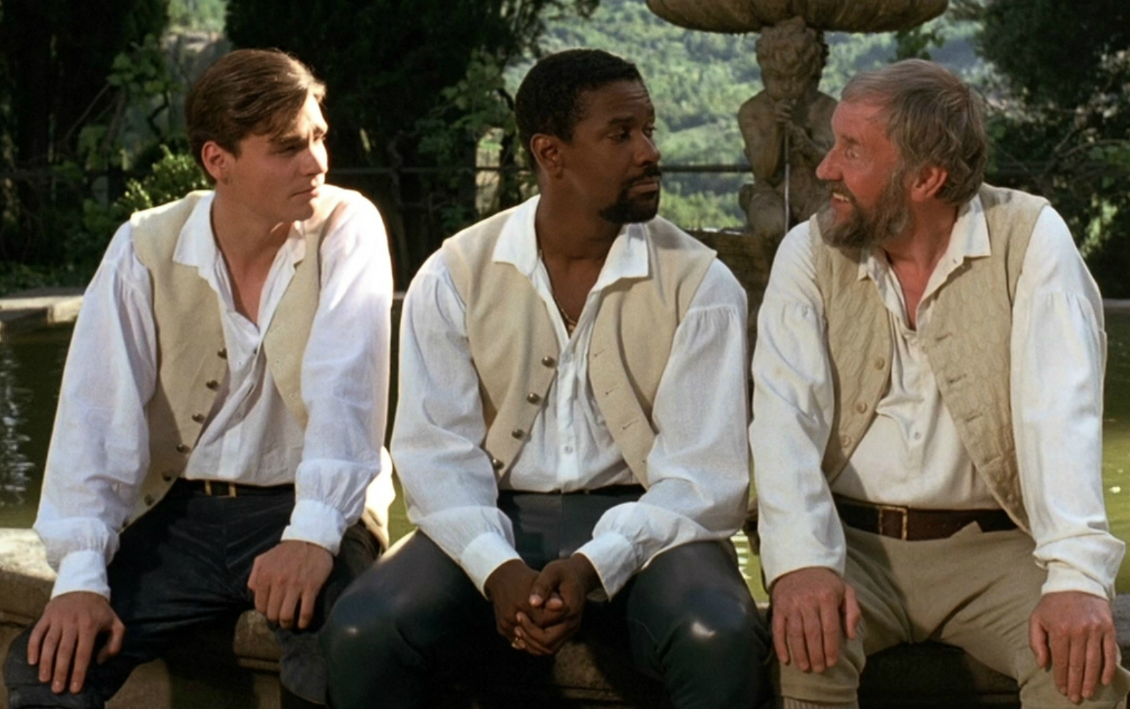
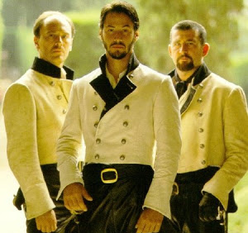
Love Plot
Hate Plot
Claudio
Don Pedro (Denzel)
Leonato
Conrad Don John Borachio

Slide 4
Hate Plot
Sources
Targets

Slide 5
Love Plot
Sources
Targets

Slide 6
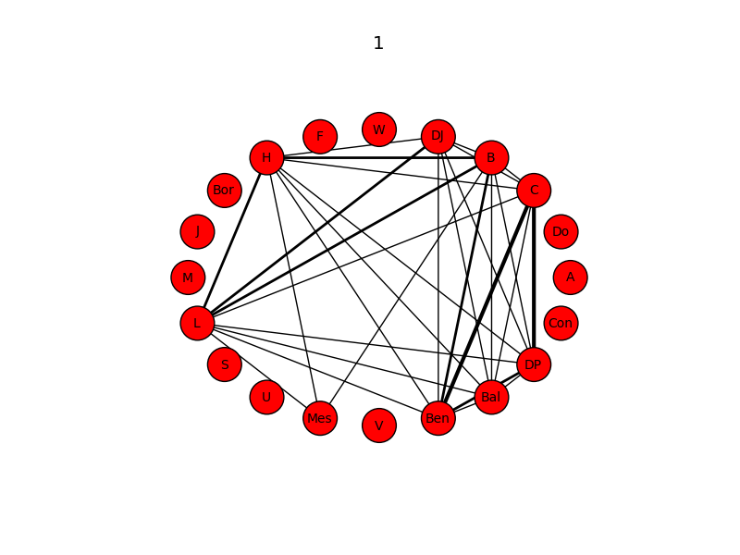
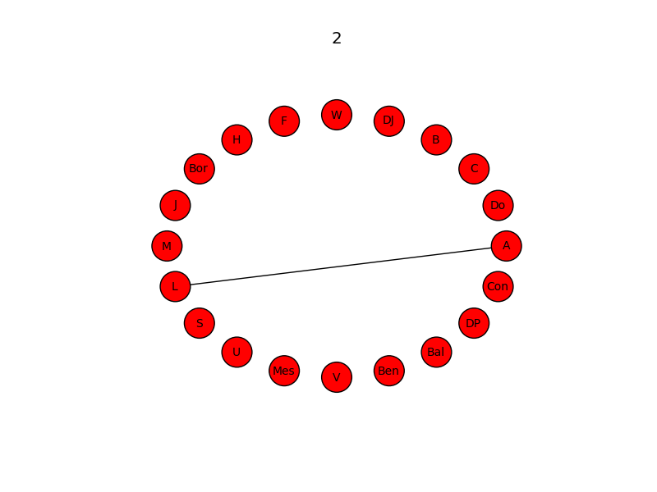
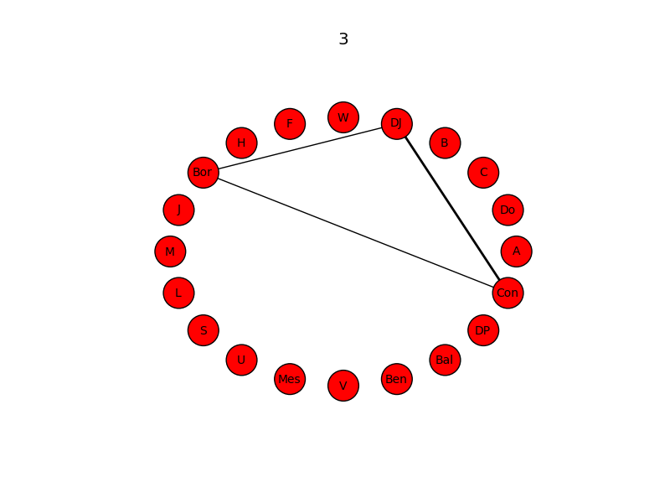
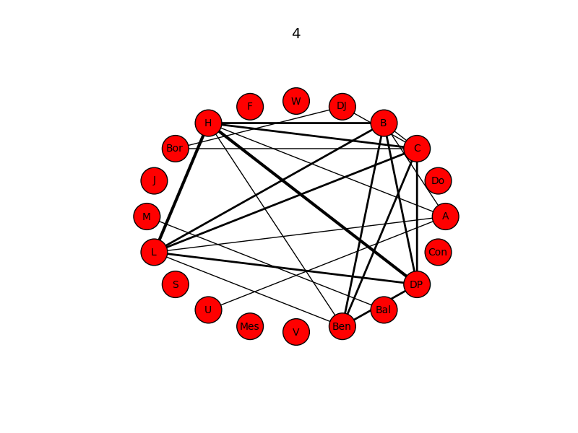
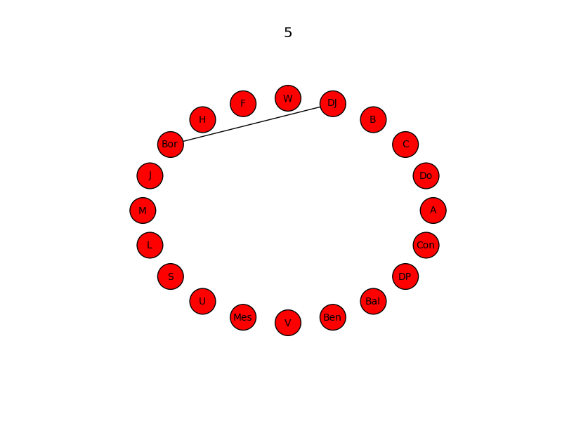
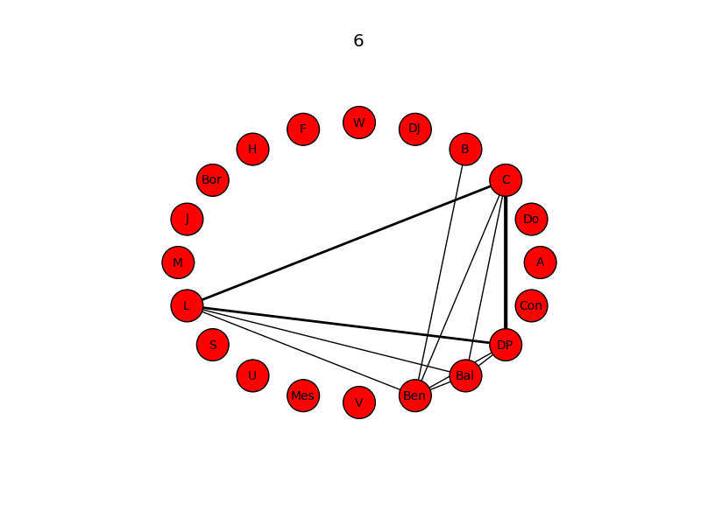
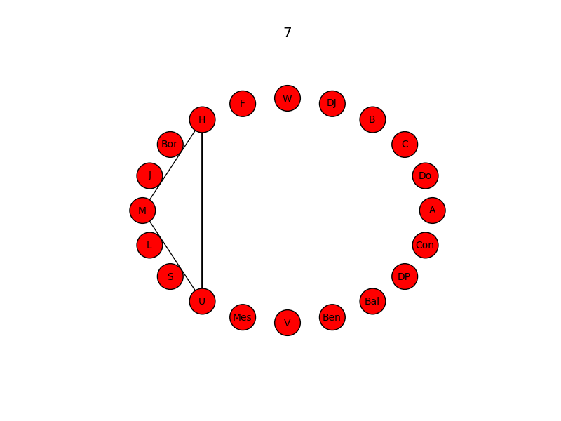
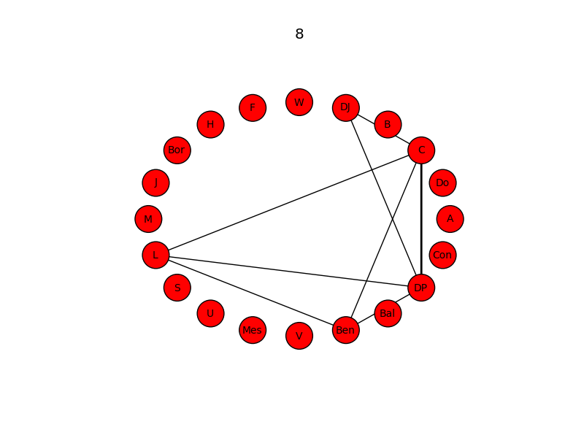
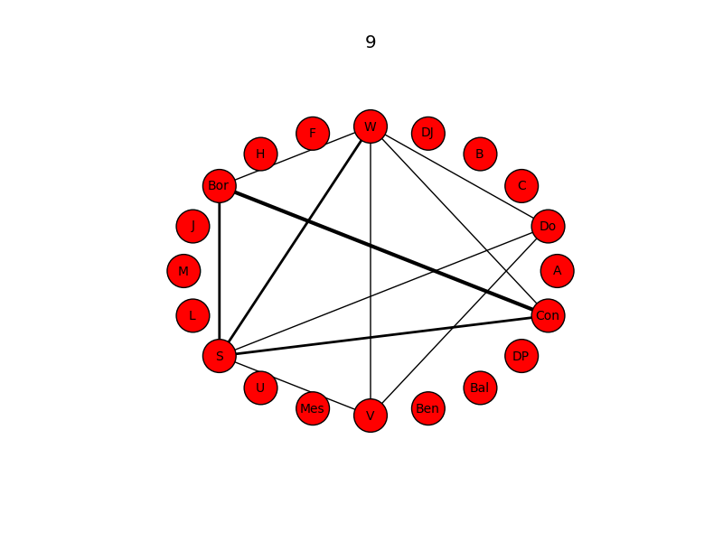
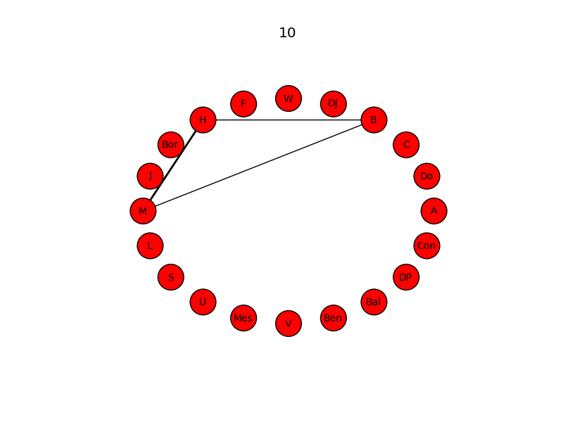
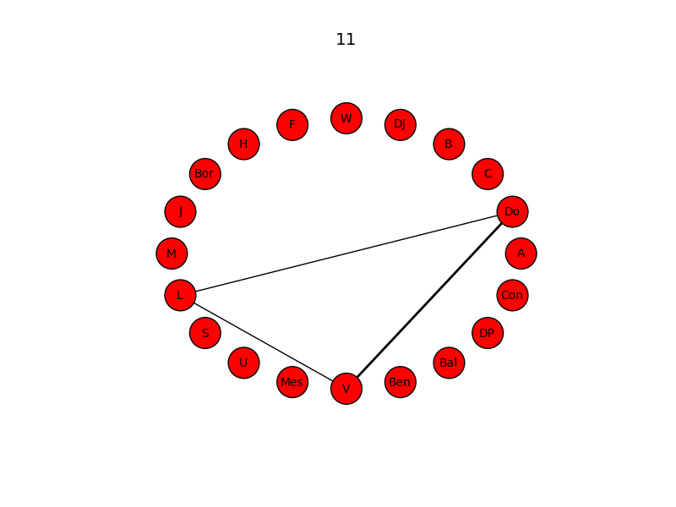
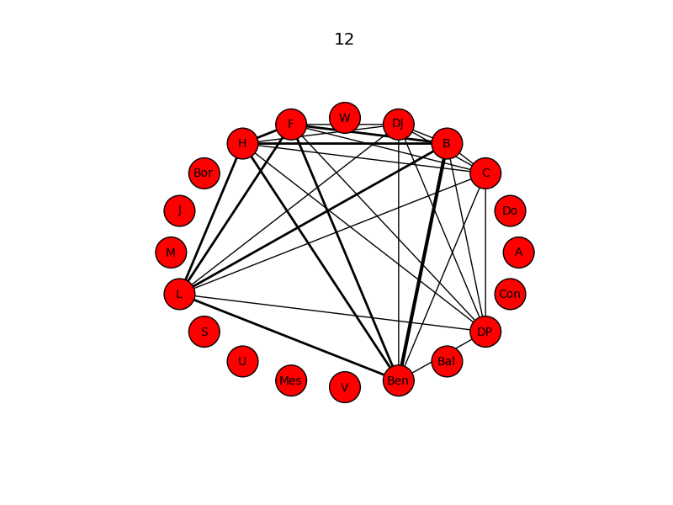
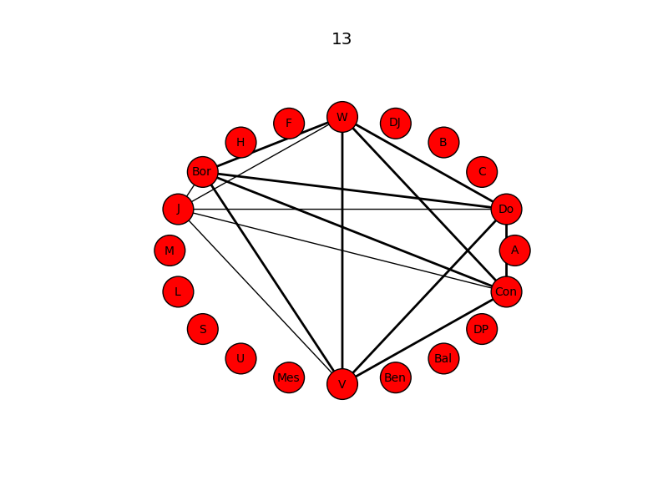
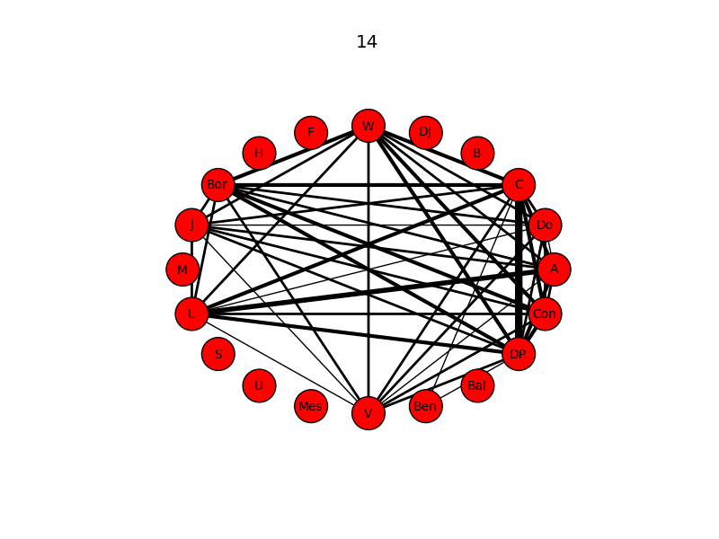
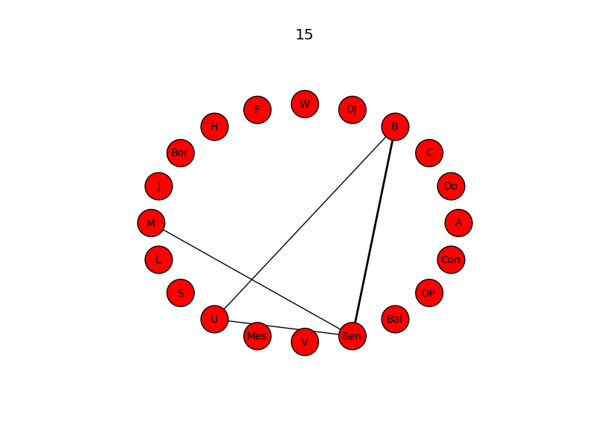
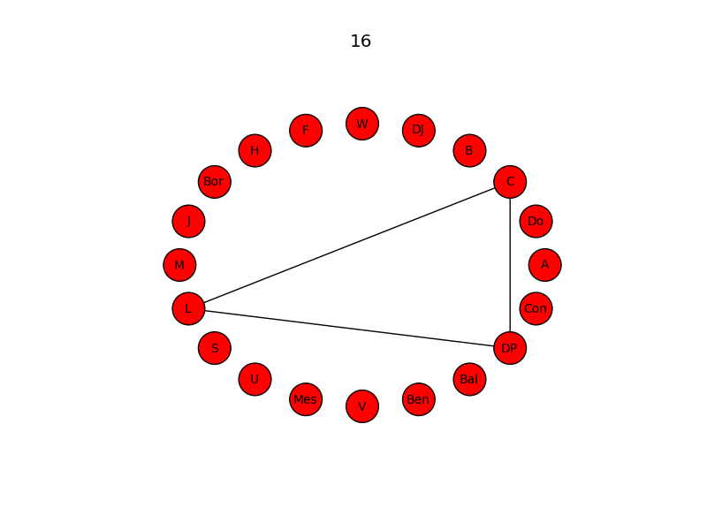
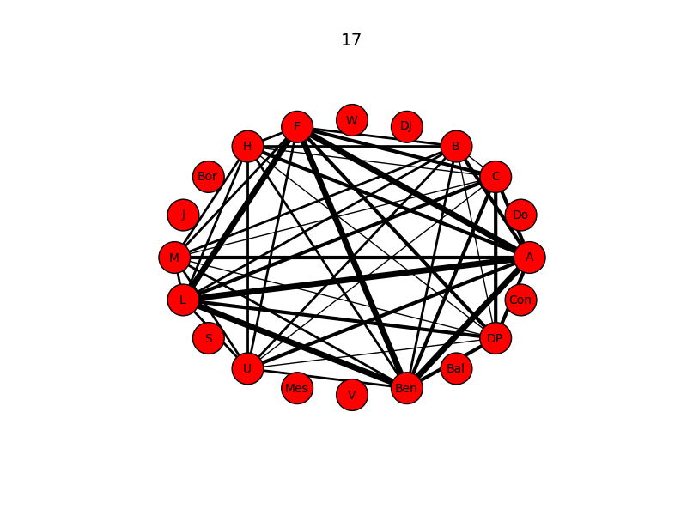

Slide 7
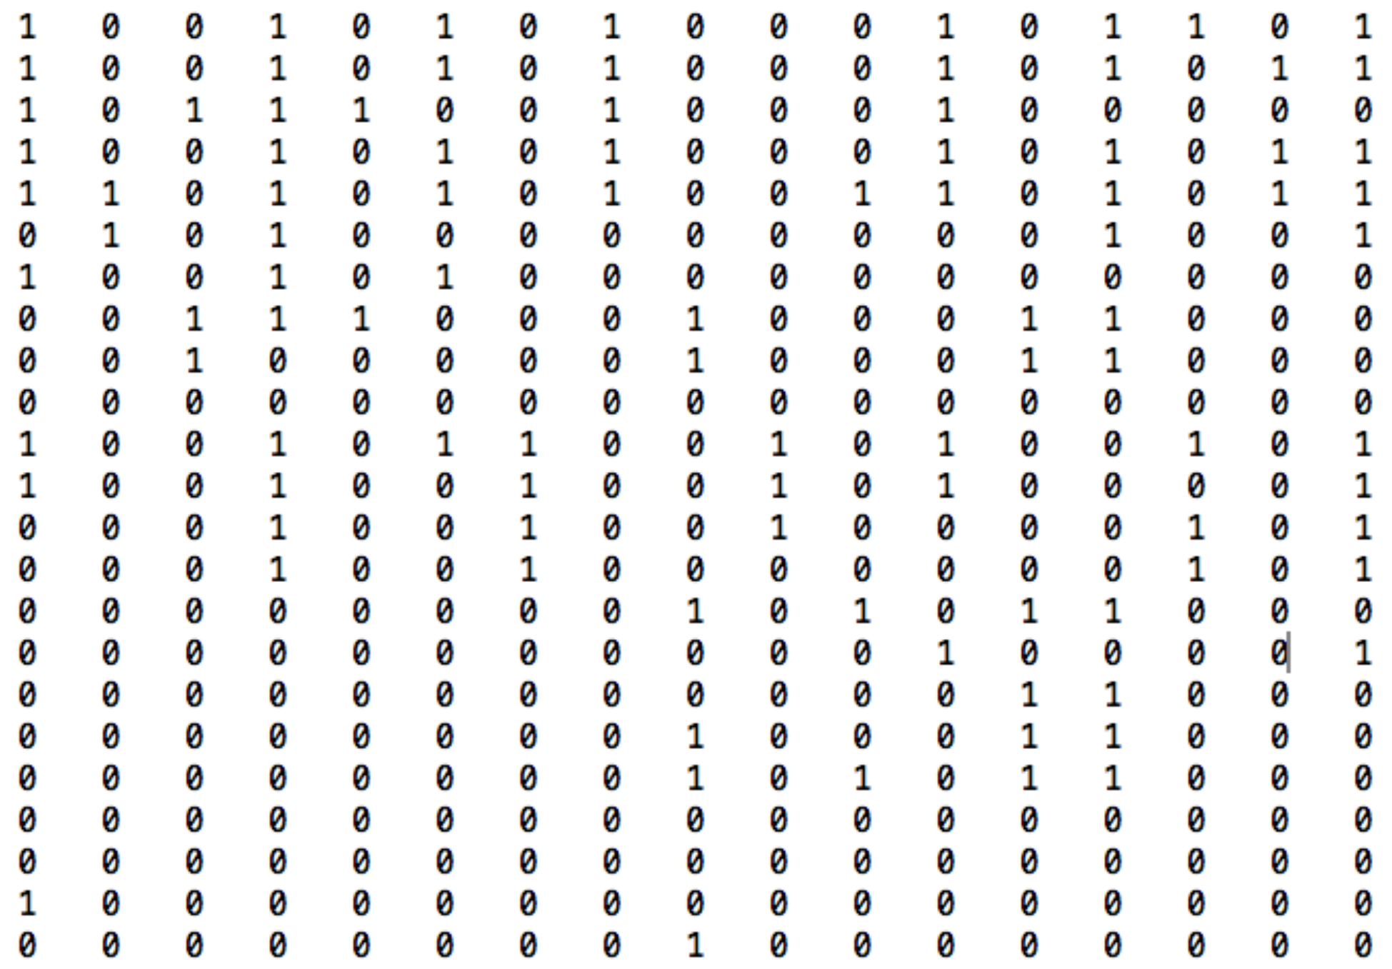
Scenes
Characters

Slide 8
Scenes
Characters
X_{n}^{k}
X_{n+1}
Y_{n}

Slide 10
Warning ! ! ! ! !
Unfounded Qualitative
Speculation Eminent

Slide 11
0.6
0.5
0.4
Conrade → Claudio
Borachio → Claudio
TE [bits]
Don John → Claudio
0.3
0.2
0.1
50 100 150
200 250 300
2 4 6 8 10 12 14
Rank
Total Shared Edges

